Slide 1
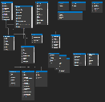
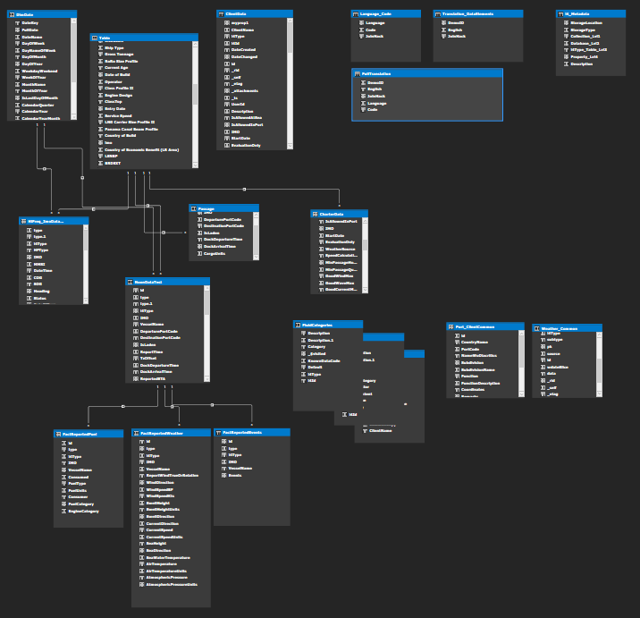
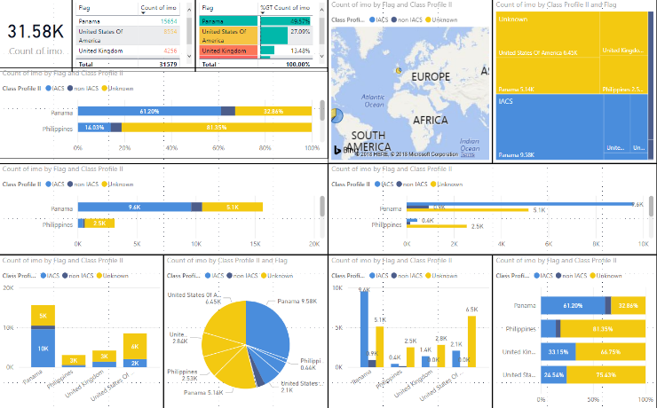
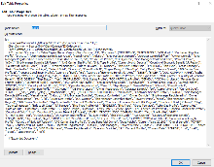
Data Ingestion
Mastered Data Sources and Services (SSOT)
Data Modeling and Calculation
Data Visualization and Analytics
Web Services
Raw Client Data
M Query
Data Mastering: Data Validation and Rules Engine
Azure Data Lake
Live Query Mode
(non-dynamic, static, Dim, look-up tables – Flat Files)
(Data is physically imported and persisted in the model)
ETL, ELT // Python, etc…
Azure CosmosDb
{JSON}
Data Ingestion:
Data received from clients: any format
Parse (cleaning – shaping)
Validation – Does it conform to data (parsing) – legal values
We use Python to transform data to our JSON Structure (Data Reception Phase)
We run Data Quality Rules on data to determine if it is acceptable (Data Validation Phase)
Rules - Does it conform to business rules (rules engine)
We ingest/persist data in JSON in a Mastered format (rules validated) (Data Mastering Phase)
Mastered Data Sources:
Can be Structured, Semi-Structured, or Unstructured
This should be the original source data AFTER it has been Mastered (Data Mastering Phase)
We will want to MASTER the data “Single Source of Truth” (SSOT) as it is persisted in this layer
Data is available for consumption by downstream systems
Data Modeling and Calculations:
Data Sources are accessed via M Query (Query Phase)
Tables are created from custom queries (transformations occur)
Tables are JOINED / Related according to Dimensional Data Modeling best practices : Kimball Group (Modeling Phase)
Calculations and additional transformations occur in the modeling phase (Calculation Phase)
We replicate the Master model for each clients using ONLY their data (Multiclient deployment) – each client sees only their version of the data model (via Power BI in React)
*Virtual Data Warehouse / Data Mart
Data Visualization and Analytics
Power BI connects to the Azure Analysis Services (AAS) Tabular Data Model in LIVE Mode – they see only their data
End-Users can interact with Power BI (embedded in React Components in i4 web app)
Power BI generates and executes LIVE queries back to the AAS Tabular Model any time a user interact with a visualization

